Slide 1
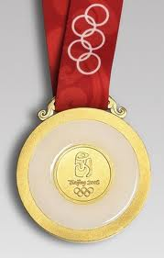
Student Health Association
Red Door Coaching and Training
Promoting Exceptional Customer Service

Slide 2
Introductions
Red Door – passionate about Service. Worked with Universities/NHS/Retail/ Hospitality
Domestics – toilets, fire, phones

Slide 3
What we are going to do in this session
Examine ‘Exceptional Customer Care’
What it is
Why should we bother?
Ways to deliver it
Have some fun and win some prizes!

Slide 4
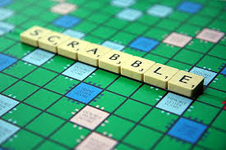
What is Excellent Service?
Teams of 4-5. Each with a bag of scrabble letters.
Use the letters to spell out ‘Excellent Service’. Now use the rest of the letters and fit into the grid any words that you associate with excellent service.
Prize for the team using most of
their letters.

Slide 5
Customer Service means
Doing ordinary things extraordinarily well
Going beyond what’s expected
Adding value and integrity to every interaction
Being at your best with every customer
Discovering new ways to delight those you serve
Surprising yourself with how much you can do
Taking care of the customer like you would take care of your grandmother

Slide 6
How easy is this to deliver?
In your teams:
Rate yourself out of 10 and share your score
Crucially – what stops you from being a 10?

Slide 7
Exploring Customer Service
Team A – Why should we bother?
Team B –What are the skills and behaviours required?
Team C – Your Top Tips to deliver this

Slide 8
How can we do it?
4 key behaviours
Cannot fail to deliver good customer care
Word Search
Prizes up for grabs!

Slide 9
Service Behaviours Wordsearch
O V F S W H E Z Q L D F
X W V J N U B K U Q E W
E P N R L Y E F W K N X
B V Y E A N T E C P I E
J K I E R C B B L S M P
C Q P T E S B S Z F R L
Y E B P I R H F W W E X
B C S A E S J I D I T I
P E J Z G J O V P S E B
R H L G W A W P Z Q D T

Slide 10
The Behaviours
PROD
Being Positive
Being Respectful
Taking Ownership
Being Determined

Slide 11
Session Review
Examine ‘Excellent Customer Service’
What it is
Why should we bother?
Ways to deliver it
Have some fun and win some prizes!

Slide 12
Finally
In your teams-
Write tomorrow’s newspaper headline about today’s event

Slide 13
Thank You
Red Door
Coaching and Training
www.reddoorcoachingandtraining.co.uk

