Slide 1
Ten Years in the Life of a Nurse Prescriber at Students’ Health Service
Presented by Sarah Windatt

Slide 2
Introduction
In 2004 I became an Independent Nurse Prescriber.
It changed my working life
Notes:
Tip: Add your own speaker notes here.

Slide 3
Background Information
Started at Students’ Health Service (SHS) in 1996
Came from CCU and no primary care experience
Joined team of 1 full time and 1 part time nurses and 5 doctors
Based in 2 Victorian houses knocked together over several floors

Slide 4
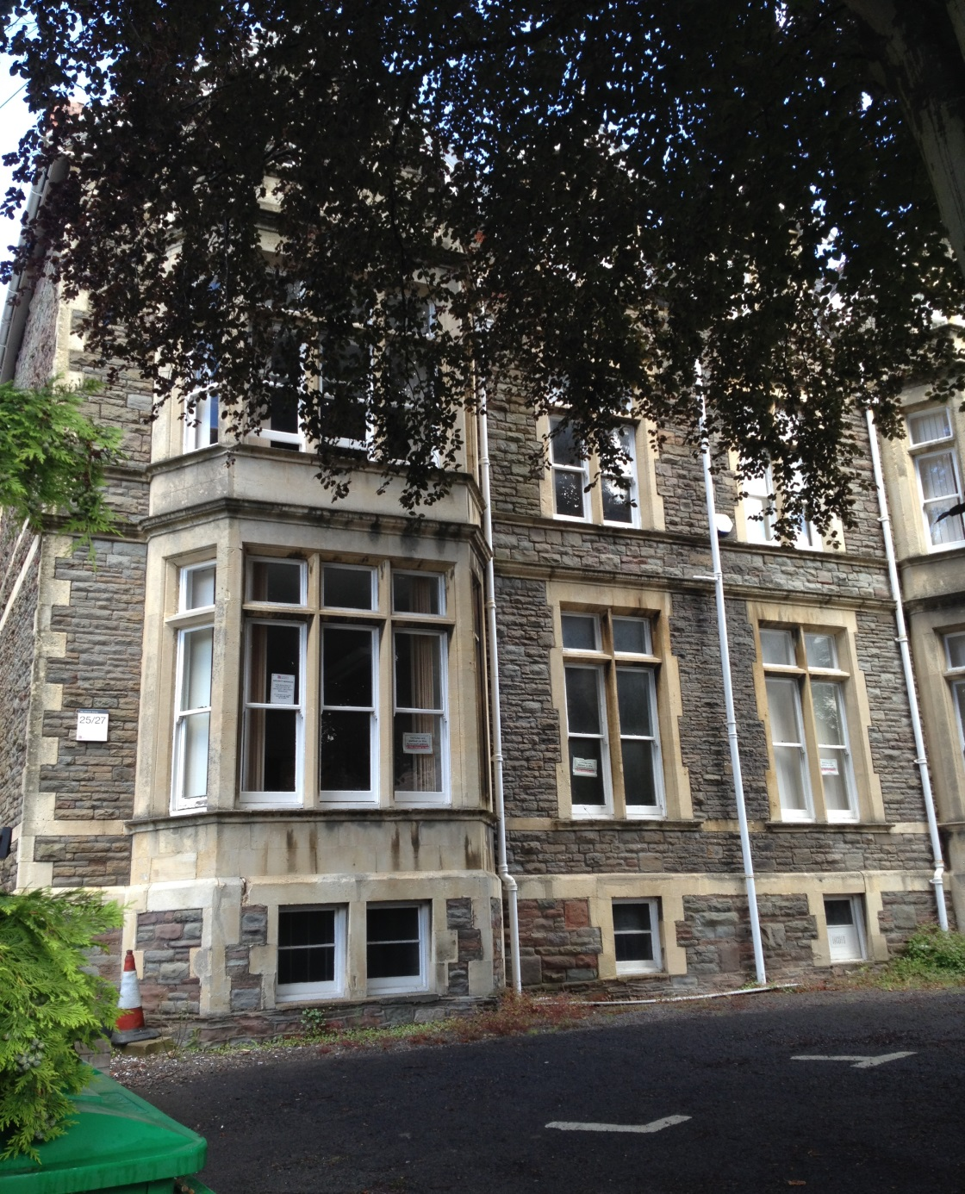

Slide 5
No PC’s for the medical staff – all notes taken on cards/ Lloyd George
Very little nurse led care
Doctors initiated travel immunisations and contraception
No patient group directions (PGD’s)

Slide 6
Mainly in house training for the nurses
Many referrals to doctors from the nurses
Nurses mainly gave advice or practical intervention eg taking swabs, giving immunisations, wound care
Very little training for practice nurses available

Slide 7
A Brief History of Nurse Prescribing
1978 – Royal College of Nursing (RCN) proposed nurses should have authority to prescribe dressings and topical treatments (Jones 1999)
1986 – Cumberlege Report concluded district nurses (DN’s) and health visitors (HV’s) should be allowed limited prescribing rights
Notes:
Even when I started at SHS in 1996, the government was considering allowing nurses to have a limited prescribing role. As long ago as 1978…
Cumberlege report-first official report to call for nurse prescribing. 1st Crown report considered implications that nurse prescribing raised

Slide 8
1989 – First Crown report endorsed nurse prescribing and successful private members bill led to primary legislation (Medicinal Products; Prescription by Nurses etc Act 1992)
1998 – First training course for Community Nurses with very limited formulary
1999- Second Crown Report – ‘Review of Prescribing, Supply and Administration of Medicines’.
Notes:
2nd crown report - Since then many changes in legislation to extend prescribing responsibility to non-medical prescribers.

Slide 9
2003 – Introduction of Supplementary and Extended Formulary Nurse Prescribing
2006 – Nurses can prescribe for any medical condition within their competence including some controlled drugs
2012 – Nurses allowed to prescribe schedule 2-5 controlled drugs therefore opening up entire BNF, providing they work within their competency (NMC 2010)
Notes:
2006-drs v strongly opposed to opening up of BNF as felt nurses not trained to diagnose disease - overruled

Slide 10
Independent Nurse Prescribing
Approximately 19,000 independent nurse prescribers (RCN, 2012)
Course offered at universities across the country
> 3 years clinical practice required before allowed to take course
Level 3 or Masters level
Clinical supervision required during and after qualification

Slide 11
Ten years ago…….
I qualified as an extended and supplementary nurse prescriber
Trained at University of West of England
Second cohort in Bristol to take the course
Notes:
Supplementary prescribing – voluntary partnership between an independent prescriber and supp presc, to implement agreed patient-specific CMP with pt’s agreement. Most useful in long term conditions (DH ?2002)

Slide 12
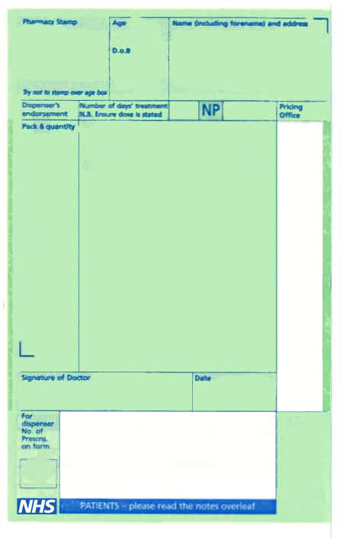
First nurse at SHS in Bristol to become a prescriber

Slide 13
Mentor was GP at SHS- supported me during and after the course
At first limited formulary to manage a range of specified medical conditions in the following 4 areas:
Minor illness
Minor injuries
Health Promotion and maintenance
Palliative care

Slide 14
The formulary covered most of the conditions seen in our patient group but the choice of what to prescribe limited
Never used supplementary prescribing
Suddenly able to complete many more episodes of care

Slide 15
2006 – BNF opened up to prescribe for any condition providing competent to do so

Slide 16
My competencies are increasing all the time
All made possible by being able to prescribe
There are now 3 independent nurse prescribers at SHS in Bristol
And we are now in purpose built accommodation…..

Slide 17
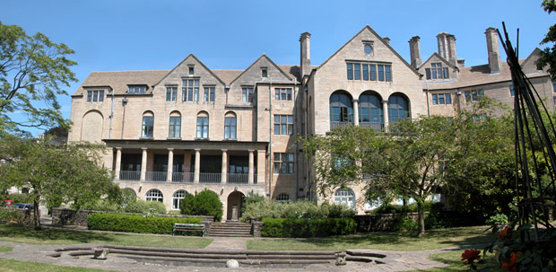

Slide 18
Group work
Discuss the advantages of having Independent Nurse Prescribers on the nursing team………..

Slide 19
Prescribing within a Students’ Health Service (SHS)
Specialist role working with students
Often first time the patients have attended a healthcare setting without a parent
Nurses in very good position to educate patients in self care, safe medicines management, expectations of what is available on the NHS
Notes:
Tip: Add your own speaker notes here.

Slide 20
Patient centered
Extends patient choice
Improves access to services for patients
Nurses generally have more time in appointments than doctors

Slide 21
Increased number of complete episodes of care
Increased job satisfaction and flexibility
Increased professional autonomy
Increased value for money compared to doctors (NPC, 2010)

Slide 22
Prescriber appointments are always fully booked
Mixture of same day and pre-booked appointments
Same day appointments normally kept back for minor illness
Duty dr telephone triage first hour of the day – many of these patients end up on nurse prescriber lists

Slide 23
The benefits of independent nurse prescribing within SHS
Minor illness
Prescribe for wide variety of ailments including tonsillitis, chest infections (with extra training), UTI, ear/eye infections
Winter illness clinics – perfect for a nurse prescriber – very few referrals to duty dr/ DNA’s
Notes:
Traditionally seen and treated by a dr. Clinical examination course – increases no of pts seen by nurse prescribers

Slide 24
Wound care/ minor injury/ post-operative care
Prescribe for wound infections
Act upon wound swab results
Dressings for patients with long term wound care
Notes:
Tip: Add your own speaker notes here.

Slide 25
Dermatology
Treatment of acne – topical and oral treatment with regular reviews
Fungal infections
Bacterial infections
Mild eczema / dermatitis

Slide 26
Contraception
Prescribe all methods of contraception including combined and progestogen only pills, depo provera
Prescribing of emergency hormonal contraception outside of PGD and Ulipristal (Ella One)
Fit / remove implants (after training) - prescribe the implant and local anaesthetic
Notes:
Level 2 service at Bristol

Slide 27
Sexual Health
Full sexual health assessment including treatment of sexually transmitted infections (STI’s)
Treatment of contacts of STI
Treatment of non-STI’s eg thrush and bacterial vaginosis

Slide 28
Chronic Disease Management
Changes to medication e.g. inhalers, thyroxine
Commencement of new medication
Repeat prescriptions
Nurse led service with appropriate referral when necessary

Slide 29
Travel
Fully nurse led service
Extra training eg travel diploma, enables nurse to run specialist clinics
Prescribe anti-malarials
Set up PSD’s for other nurses to give courses of vaccines

Slide 30
‘Non-medical prescribers are integral to the ongoing reform of the NHS and are at the start of both their extended role in service delivery and commissioning activity’ (Dr James Kingsland, NPC, 2010)

Slide 31
Questions and Discussion

Slide 32
References
British National Formulary www.bnf.org
Department of Health (April 1989) Report of the Advisory Group on Nurse Prescribing, DoH, London (First Crown Report)
Department of Health ((March 1999) Review of Prescribing, Supply and Administration of Medicines DoH, London (Second Crown Report)

Slide 33
Department of Health and Social Security (1986) Neighbourhood Nursing: a Focus for Care DoH, London (Cumberlege report)
Jones, M (1999) as cited by Cooper et al (2008) Non Medical Prescribing in the United Kingdom) Journal of Ambulatory Care Management 31(3),244-252
Kingslan Dr JP (2010) Foreword to NPC (2010) Non-medical prescribing. A Quick Guide for Commissioners

Slide 34
Nursing and Midwifery Council (2010) Standards for Medicines Management London www.nmc-uk.org
Royal College of Nursing (2013) Nurse Prescribing Update RCN Publishing, London

