Slide 1
Dr. Geetanjali Gangoli
Crimes in the name of honour
g.gangoli@bristol.ac.uk

Slide 2
Terminology used
"'Honour based violence' is a crime or incident which has or may have been committed to protect or defend the honour of the family and/or community.“
“…an umbrella term to encompass various offences covered by existing legislation. Honour based violence (HBV) can be described as a collection of practices, which are used to control behaviour within families or other social groups to protect perceived cultural and religious beliefs and/or honour.”
(CPS, 2014)
Notes:
an umbrella term to encompass various offences covered by existing legislation. Honour based violence (HBV) can be described as a collection of practices, which are used to control behaviour within families or other social groups to protect perceived cultural and religious beliefs and/or honour. Such violence can occur when perpetrators perceive that a relative has shamed the family and/or community by breaking their honour code.

Slide 3
Terminology used
"'Honour based violence' used academically and in policy, but problematic as
Seems to accept the rationale of honour used by perpetrators to commit the violent act(s)
Associated with particular ethnic communities and practices.
I prefer to use the term ‘crimes (committed) in the name of honour’ as makes a clear distinction between the (violent) act(s) and the rationale.
Notes:
Honour seen as positive generally…
Tantamount to accepting the rationale that perps of dv may use…for e.g. nagging wives violence
Associated with particular ethnic communities and practices…more later.

Slide 4
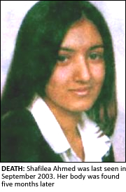
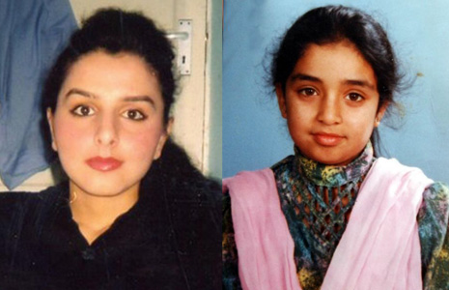
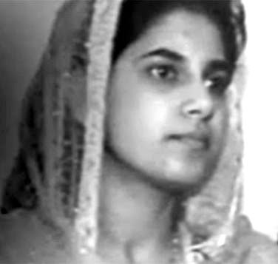
Notes:
In 2003, Shafilea Ahmed a 17 year old girl from Warrington vanished from her home after telling friends of her fear of being forced into a marriage. Five months later her body was found in the lake district and the coroner saw that she was a victim of a very vile murder. Her initial drinking of bleach was a desperate measure to avoid a forced marriage. (mention recent judgement where her father convicted and the judge said that this was a case of murder and not honour related)
in 2006, Banaz Mahmood was murdered on instructions from her family following them learning of a relationship with a man whom they disapproved (suitcase).
In 2007, a mother-in-law and husband were charged with the murder of Surjit Kaur Athwal . She had been murdered in India following her husband’s family learning of her plans to divorce him.
These are all considered forms of crimes in the names of honour…

Slide 5
Crimes in the name of honour
Gender relations that problematise and control women’s behaviour and sexuality
Women policing other women’s behaviour
Collective decisions regarding punishments
Women’s participation in killings
Ability to reclaim honour through killings or enforced compliance
State sanction of such killings through recognition of honour as motivation and mitigation (Sen, 2006).
Notes:
Purna Sen has identified six key features of crimes of honour, including: gender relations that problematise and control women’s behaviour and sexuality; women policing other women’s behaviour; collective decisions regarding punishments; women’s participation in killings; ability to reclaim honour through killings or enforced compliance; and State sanction of such killings through recognition of honour as motivation and mitigation (Sen, 2006). She suggests that honour crimes have more in common with dowry related murders in countries like India and femicide in various contexts than those involving sexual jealousy or what she terms ‘individualistic fit of fury’ (Sen, 2006:51). Seen thus, the focus is more on collective honour and shame, as reflected in the behaviour of women, rather than the individual.

Slide 6
Some accepted forms of crimes in the name of honour…
Forced marriage
Murder of young people escaping forced marriage
Homophobic attacks where such attacks are articulated in the name of honour
Female genital mutilation
Notes:
Any others? Ask…

Slide 7
Setting HBV in the context of the UK
Experiences of violence against women among BME communities in the UK
Differential service provision, institutional racism and cultural concepts such as izzat (honour) and sharam (shame).
State and community responses, e.g. new law criminalising forced marriage (2014)
Notes:
Why is this important? Because dv is still not criminalised…

Slide 8
Forced marriage as a form of crime in the name of honour?

Slide 9
Forced marriage
What is forced marriage?
“Where one or both parties are coerced into a marriage against their will and under duress. Duress includes either physical and/or emotional pressure. It is very different from arranged marriage, where both parties give their full and free consent to the marriage. The tradition of arranged marriages has operated successfully within many communities and many countries for a very long time” (Home Office, 2002)

Slide 10
Forced marriage as ‘crimes in the name of honour’
Forced marriage understood within the lexicon of ‘shame’ and ‘honour’, and this is certainly a valid argument to some extent, however:
Forced marriage takes place in a variety of contexts, across different historical trajectories, and to women and men of different ages.

Slide 11
Forced marriage: which communities
Forced marriage seen as pathology of some cultures, specifically of South Asian and/or Muslim communities (FMU website, 2010). However:
It happens in a range of religious and ethnic communities – Chinese (self defined as atheist), Middle Eastern (Muslim and atheist), Indian (Sikh and Hindu), Bangladeshi and Pakistani (Muslim), African (Christian, Muslim), upper class aristocratic families
Notes:
Forced marriage as pathology of some cultures, specifically of South Asian and/or Muslim communities:
Forced marriage both in the UK and in Europe has at times been constructed as pathology of some cultures, specifically of South Asian and/or Muslim communities (Samad and Eade 2002; Razack 2004) and Romani communties (Oprea 2005). Other literature suggests that forced marriage and child marriage are ‘harmful cultural’ practices (Interights 2000: 21) and therefore, there needs to be an assessment of ‘traditional laws’ that involves ‘women and girls who are affected by these laws’ (Outtarra 1998). Some literature grapples with the issue of how to avoid feeding into a celebration of European superiority or national identity while confronting and naming violent practices within minoritised communities, and notes the ways in which ‘culture clash’ works into strengthening racial stereotypes (Volpp 2000; Razack 2004: 154; Madsen 2003), while multicultural acceptance of cultural practices is identified as encouraging forced marriage (Razack 2004). It has also been suggested that forced marriage is a product of immigration rather than a ‘tradition’ from another context (Phillips and Dustin 2004, 543). There is also literature addressing how forced marriage is against the tenets of different religions (Caroll 1998) and a misinterpretation of culture (Gangoli et al. 2006).
Forced Marriage happens in a range of religious and ethnic communities – Chinese (self defined as atheist), Middle Eastern – Iranian, Iraqi Kurds Arab, Moroccan and Jordanian (Muslim and atheist), Indian (Sikh and Hindu), Bangladeshi and Pakistani (Muslim), African – Sierra Leonne, Uganda Kenya, Ghana and Cameroon (Muslim and Christian)
AM as cultural practice: South Asian and Middle Eastern Muslim and Hindu survivors identified arranged marriage as a cultural practice, but also recognised that there could be slippage between arranged and forced marriage, FM took place at the broader level of cultural expectations. .

Slide 12
Role of culture/religion
Attributed to religious identity
…it is not really permissible in Islam to speak to the person much before the marriage. Because say for example, well they do it more for chastity, so should anything happen from meeting at first…and they don’t want to get married afterwards, then that’s the problem, that’s a blot on the person’s image, like honour and respect (cited in Hester et al. 2008).
Izzat and sharam: Control over sexuality, socialisation, control over dress; gendered control over women (Gangoli & Chantler, 2011)
Notes:
Culture at the level of lack of options and control over women’s sexuality. Two respondents, both engaged at the time of the interview alluded to the lack of options available to them within their religion (i.e Islam) and community (Bengali) in terms of marriage options:
…personally in Islam it is not really ok to mix with boys, I don’t really talk to guys that much. And what they (family) do is, they obviously find a partner first…(BRW4).
When asked by the interviewee whether she had a chance to meet her potential spouse alone, she demurred on the grounds that it would be against her religion, and attributed this to control over chastity, primarily of women:
…it is not really permissible in Islam to speak to the person much before the marriage. Because say for example, well they do it more for chastity, so should anything happen from meeting at first…and they don’t want to get married afterwards, then that’s the problem, that’s a blot on the person’s image, like honour and respect (BRW4).

Slide 13
Financial/structural issues
Bride price
Because if a father thinks, believes that he can get so many manner of cattle or dowry, out of this one girl, and he can use that for three of his sons, to marry, to get them wives, then he’s going to get that girl out of school at thirteen (Ugandan FG).
Notes:
Bride price – important in survivor and focus group accounts from African contexts (non Muslim). While bride price is linked to poverty, it is also a cultural practice that is seen in these contexts as being linked to the sale and devaluation of women:
R3: Yes. Because if a father thinks, believes that he can get so many manner of cattle or dowry, out of this one girl, and he can use that for three of his sons, to marry, to get them wives, then he’s going to get that girl out of school at thirteen
R2: And that income is used for the sons to get married. So again it’s still using you know, exploiting the girl child (Ugandan FG).

Slide 14
Outcomes of Forced Marriage: Domestic violence and abuse Sexual abuse Child abuse Female Genital Mutilation Human trafficking 12 ‘honour’ killings a year

Slide 15
Outcomes of Forced Marriage in Young People:
When a young person is forced into a marriage:
Emotional and Psychological abuse Self harm Depression Become withdrawn Use harmful coping mechanisms (Drugs, alcohol etc)
When a young person’s parents have been forced into a marriage:
Exposed to domestic violence and abuse Victims of child abuse May become victims of forced marriage themselves
Notes:
Shab
- Being forced into marriage and being a child with parents having been forced into marriage

Slide 16
Summary
Forced marriage includes issues of ‘honour’ but also of structure.
The category of ‘honour’ may tend to exoticise the issue of GBV, but on the other hand, may also provide context.
Are crimes in the name of honour another name for GBV in BME communities?
As with forced marriage it may be important to look at structural issues in other forms of crimes in the name of honour.

Slide 17
Discussion…
Is the category of HBV or crimes in the name of honour useful?
Notes:
Prompts – is it better to call it gender based violence? Or dv?

